Slide 1
Introduction to APIs
By: HIRA KIRAN

Slide 2
What is APIs?
Application Program Interface
Allow Communication b/w Client and Server
Act like a middleware

Slide 3
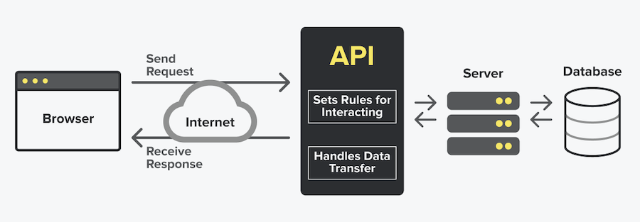
How APIs Work?

Slide 4
HTTP Methods
Get
POST
DELETE
UPDATE

Slide 5
JSON STRUCTURE

Slide 6
JSON STRUCTURE
JavaScript Object Notation
Used to sent data between Computers
JSON is language independent
Lightweight data-interchange format

Slide 7
JSON VALUE
In JSON, Values must be one of the following data types:
Number
String
Bool
Object
Array
Null

Slide 8
JSON STRUCTURE
JSON data is written as a key-value pair.
Example:
“Name” :”Hira”,
“id”:1,
“Gender": "Female”,
“City": "Faisalabad”

Slide 9
JSON OBJECT
These { } represent JSON Object, it could be string, integer bool etc.
Example:
{
“Name” :”Hira”,
“id”:1,
“Gender": "Female”,
“City": "Faisalabad”
}

Slide 10
NESTED JSON OBJECT
An object within a object.
Example:
{
“Name” :”Hira”,
“id”:1,
“Data”: {
“Gender": "Female”,
“City": "Faisalabad”
}
}

Slide 11
JSON ARRAYS
These [ ] represent JSON array or list, it could be string, integer bool etc.
Example:
[“Name”, “id”, "Faisalabad” ]

Slide 12
JSON ARRAY
{
“Products”: ”Fast Food”,
"data": [
{
"product_id": "1",
"product_name": "Urban Special (M)",
"rate": "799",
"categories_name": "Urban Special Pizza"
},
]
}

Slide 13
Websites For Fake APIs
JSON Place Holder (https://jsonplaceholder.typicode.com/ )
Reqres (https://reqres.in/ )
FakeStoreAPI(https://fakestoreapi.com/ )
Jsonviewer for check APIs format (http://jsonviewer.stack.hu/)
FOR MAKING MODEL WEBSITES
JSON to dart (https://javiercbk.github.io/json_to_dart/ )
Quicktype (https://app.quicktype.io/ )

Slide 14
THANK YOU

